Slide 1
Inventory Management System
Presented By: Kevin Panchal
Jaydeep Ravaliya
Jaykumar Mistry

Slide 2
Why IMS?
Running a business without an Inventory Management System is like being lost in space without a map. You might think everything is fine, but suddenly you realize you have no idea where the stock went, and your customers are floating around wondering if you even have the product they need

Slide 3
Purpose
The Inventory Management System (IMS) is designed to automate and simplify inventory tracking for businesses of all sizes.
It provides real-time updates, stock management, product tracking, and reporting, reducing human errors and improving operational efficiency.

Slide 4
Scope
The IMS focuses on key areas such as product management, stock level monitoring, supplier management, and report generation.
It aims to enhance decision-making by providing insights into inventory data

Slide 5
Goals
Develop a user-friendly and scalable web-based application.
Enable real-time inventory updates.
Automate tasks like low-stock alerts and report generation.

Slide 6
System Features
01
02
03
04
Add , Delete , Update Product
Manage stock levels and low stocks
Generate detailed inventory reports.
Notifications for low stock alerts.

Slide 7
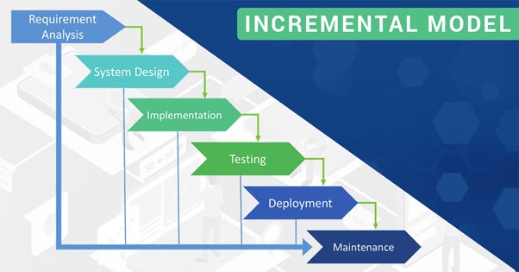
Incremental management plan

Slide 8





Technology Used

Slide 9
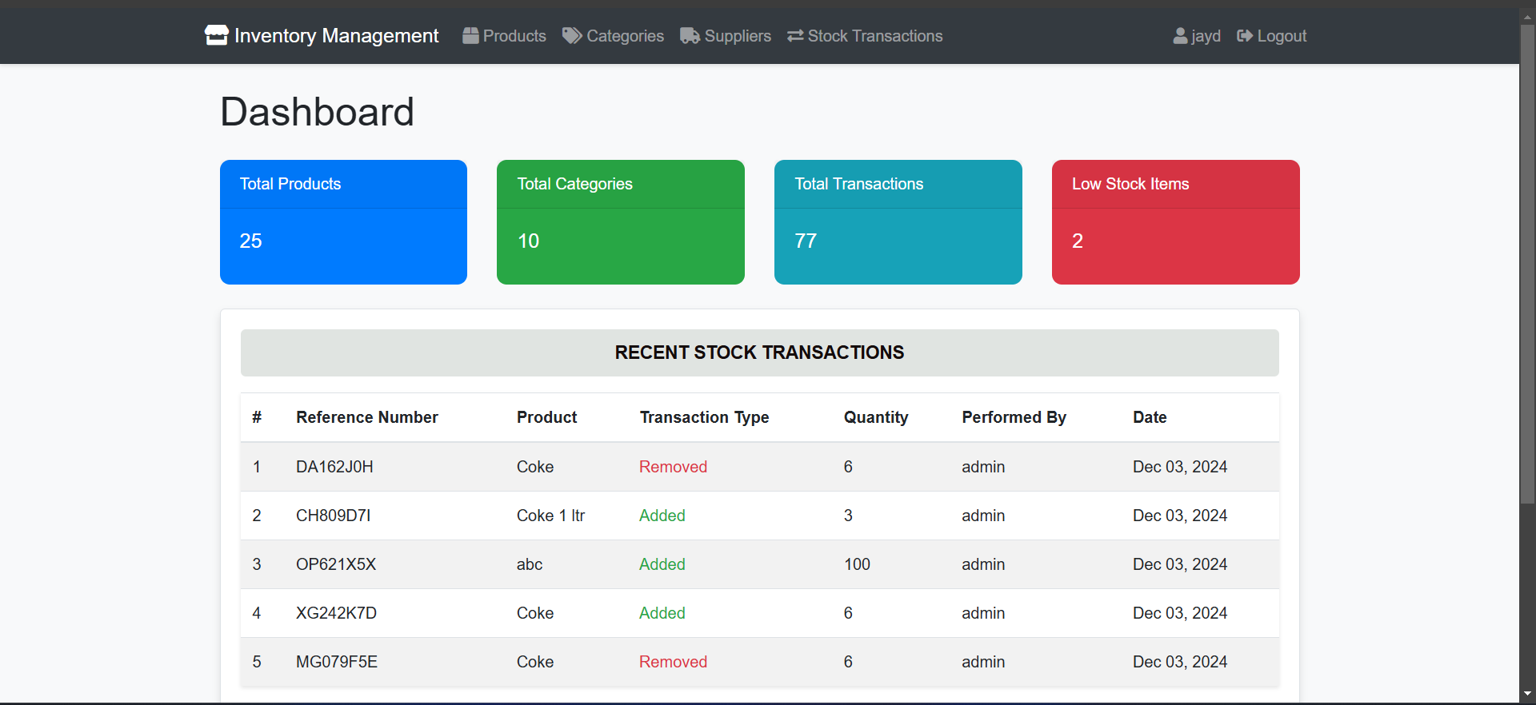
Demo
Time !!!!

Slide 10
Future Scope
Dashboard
UI / Currency
Advanced analytics tools for predictive analysis.
Multilingual UI and multi-currency pricing

Slide 11

Thank You !
We Would like to thank Dr. Yongjian Fu for overseeing and support throughout this project.

